Slide 1
Project - 5
User Analytics in the Telecommunication Industry - Overview
Name – Ashish kumar sen

Slide 2
Abstract
User analytics in the telecommunication industry has become increasingly vital for understanding customer behavior, optimizing services, and driving business growth. This study aims to explore the patterns and trends in user activity by analyzing extensive datasets, including Call Detail Records (CDR) and data sessions Detail Records (xDR). We employed advanced data analysis techniques using Python libraries such as pandas for data cleaning and handling, and machine learning models for predictive insights.
Our analysis focused on identifying key factors influencing user behavior, including call duration, frequency of data usage, and application preferences. Additionally, we implemented geospatial analysis to map user activity across different regions, providing insights into regional variations in service demand. The study revealed significant trends, such as the increasing popularity of streaming services and the impact of social media usage on network performance.
The findings from this research offer valuable insights for telecommunication companies to enhance their service offerings, tailor marketing strategies, and improve network infrastructure. By leveraging user analytics, companies can make data-driven decisions that cater to the evolving needs of their customers, ultimately leading to improved customer satisfaction and business performance.

Slide 3
Content
1. Introduction
2. Objectives
3. Methods
4. Results
5. Conclusions
Chapter - 1
1. Introduction
The telecommunication industry has undergone a transformative evolution over the past few decades, driven by rapid advancements in technology and the proliferation of mobile devices. In this dynamic landscape, user analytics has emerged as a critical tool for telecom companies to understand and cater to their customers' needs effectively. User analytics involves the systematic analysis of customer data, providing insights into user behavior, preferences, and usage patterns.
The importance of user analytics in the telecommunication industry cannot be overstated. By leveraging data analytics, telecom companies can enhance customer satisfaction through personalized services, optimize their marketing strategies to target specific user segments, and improve network performance by anticipating and addressing potential issues. Furthermore, user analytics helps in identifying trends and patterns that can inform strategic business decisions, driving growth and competitiveness in a highly saturated market.

Slide 4
Chapter - 2
2. Objectives:
The primary objective of this research is to leverage user analytics to gain comprehensive insights into customer behavior and usage patterns in the telecommunication industry. This will aid telecom companies in optimizing their services and enhancing customer satisfaction. The specific objectives of this study are:
1.Data Collection: The data collection process is a critical component of our research on user analytics in the telecommunication industry, enabling us to gather comprehensive insights into customer behavior and usage patterns. The following subsections detail the sources, types, methods, and tools used in this study.
2.Data Cleaning and Preprocessing: Ensuring the quality of data by handling missing values, removing duplicates, and correcting inconsistencies.

Slide 5
3.Exploratory Data Analysis (EDA): Analyzing the dataset to identify key features, uncover patterns, and visualize trends that impact house prices.
4.Feature Engineering: Creating new features based on domain knowledge and statistical methods to enhance the predictive power of the model.
5.Model Development and Evaluation: Building, training, and evaluating several machine learning models, including linear regression, decision trees, and random forests, to identify the best-performing model.
6.Model Deployment: Developing a user-friendly web application using Streamlit to make the prediction model accessible for user behaviour estimation.

Slide 6
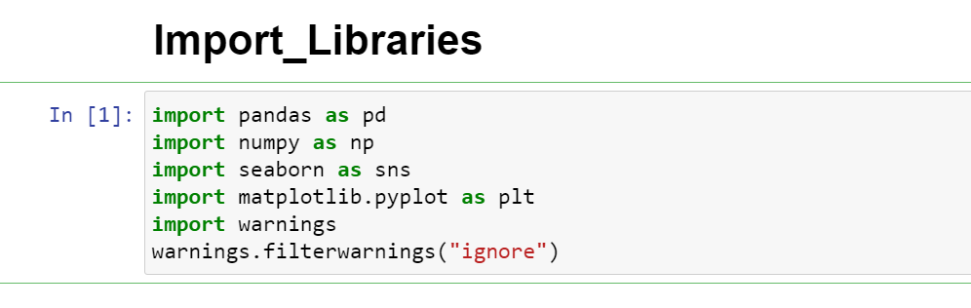
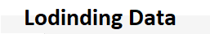
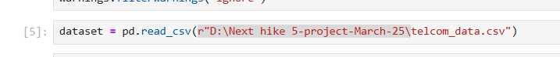
Chapter - 3
3. Methods
(i). Loading the Data:
To load the real estate pricing dataset into a Pandas DataFrame, Load the dataset provided in a CSV or Excel format into a Pandas DataFrame to facilitate easy manipulation and analysis. Using Python Pandas Library.

Slide 7
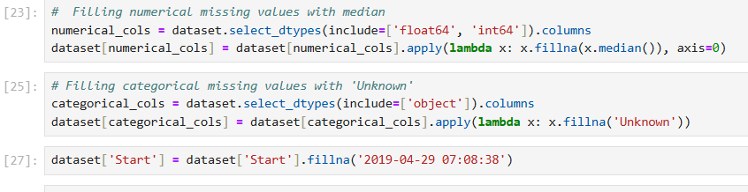
(ii). Cleaning the Data:
Cleaning the data is an essential step in the data analysis process, particularly for User Analytics in the Telecommunication Industry - Overview. It involves preparing the dataset by addressing missing values, removing duplicate entries, and fixing any anomalies or inconsistencies. This ensures that the data is accurate and reliable for further analysis.
(a). Handling Missing Values:
Missing values can occur due to various reasons such as data entry errors or incomplete records. To handle missing values, you can:
Use isnull() method to identify missing values in the dataset.
Use fillna() method to replace missing values with appropriate values, such as the mean, median, or mode of the column.
Alternatively, you can use the dropna() method to remove rows with missing values if they are not critical for your analysis.

Slide 8
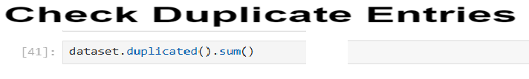
(b). Removing Duplicates:
Duplicate entries can skew the analysis results. To remove duplicates, you can:
Use the duplicated() method to identify duplicate rows in the dataset.
Use the drop_duplicated() method to remove duplicate rows and keep only unique entries.

Slide 9
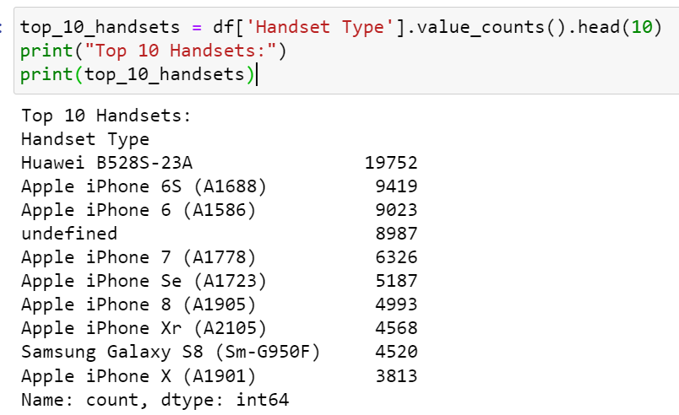
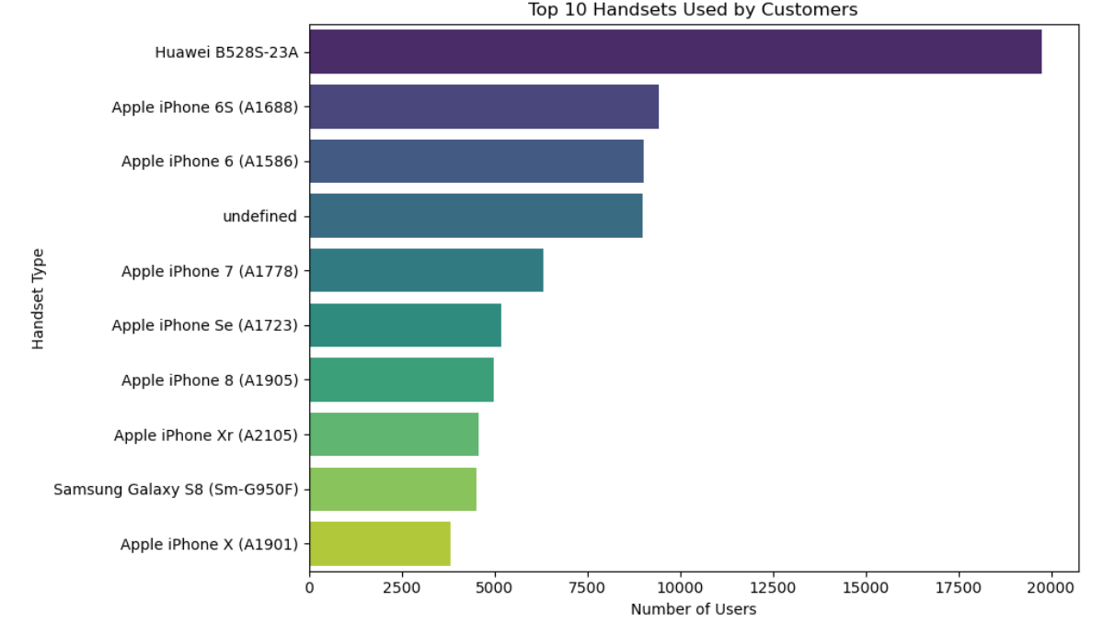
Task 1 - User Overview Analysis
1. Identify the top 10 handsets used by the customers:

Slide 10
Explanation:
1. Huawei B528S-23A is the most popular handset with 19,752 users.
2. Apple devices dominate the list with seven out of the top ten handsets.
3. Samsung Galaxy S8 (SM-G950F) is also popular with 4,520 users.
4. The presence of an undefined handset indicates a need for data cleaning.
Recommendations:
1. Targeted Marketing for Apple: Focus on upgrade promotions for users with older iPhone models. Highlight the features of newer iPhone models to encourage upgrades.
2. Competitive Strategies for Samsung: Promote the latest Samsung models, highlighting their advanced features. Implement loyalty programs for existing Samsung users.
3. Expansion Strategies for Huawei: Promote other Huawei models and introduce new devices targeting the same user base. Address the undefined handsets to convert those users into identifiable handsets for better analysis.

Slide 11
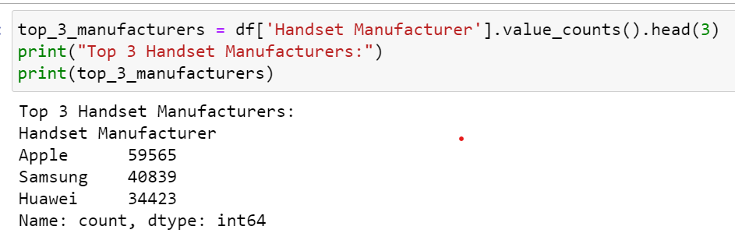
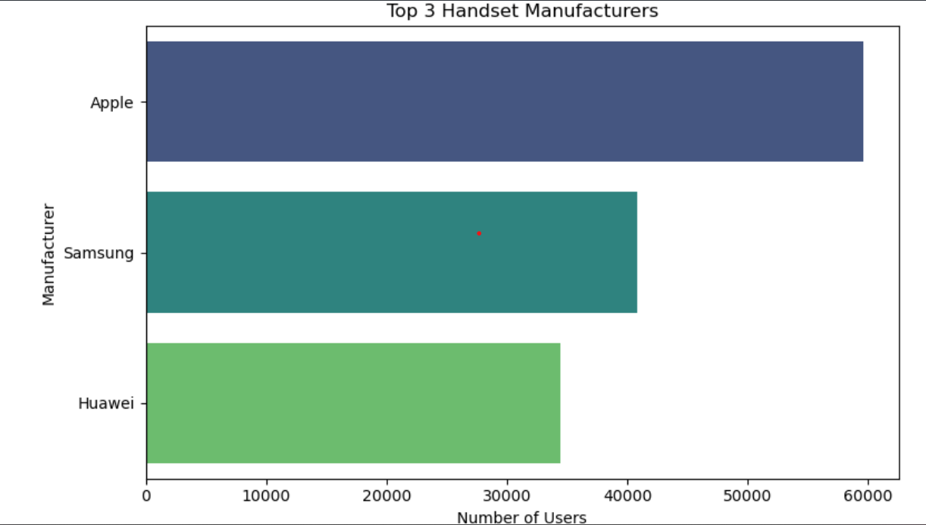
2. Identify the top 3 handset manufacturers:

Slide 12
Detailed Interpretation:
Top 3 Handset Manufacturers:
1. Apple: 59,565 users
2. Samsung: 40,839 users
3. Huawei: 34,423 users
** Sample Interpretation:
From the analysis, we observe that the most popular handsets are predominantly from Apple, Samsung, and Huawei. The top 3 manufacturers account for a significant portion of the market share:
Apple leads with 42.3% of the user base among the top 3 manufacturers.
2. Samsung follows with 29.0%.
3. Huawei holds 24.5%.
Recommendations:
1.For Apple: Focus on Top Models: Apple's top handsets should be highlighted in marketing campaigns. Emphasize their unique features and benefits to maintain and grow their user base. Loyalty Programs: Introduce loyalty programs and trade-in options to retain existing customers and attract new ones.
2.For Samsung: Innovative Features: Highlight innovative features in Samsung's top models to differentiate them from competitors. Promotional Offers: Consider promotional offers and bundles to attract customers who might be considering switching from other brands.
3.For Huawei: Market Penetration: Increase market penetration by targeting regions or demographics where Huawei is less dominant. Customer Support: Strengthen customer support and service options to enhance customer satisfaction and loyalty.

Slide 13
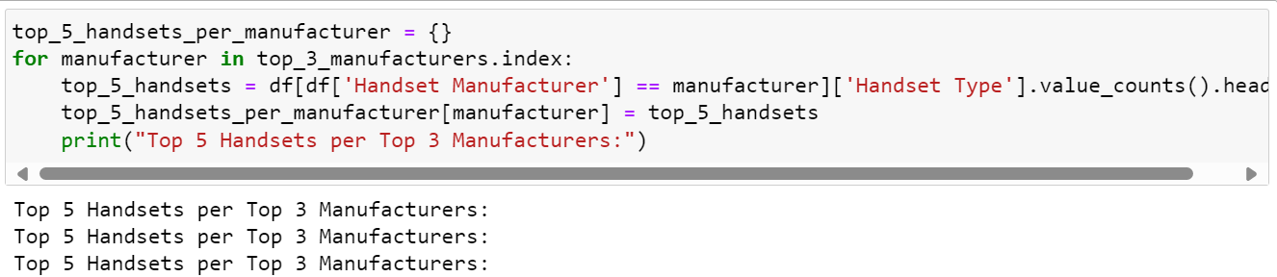
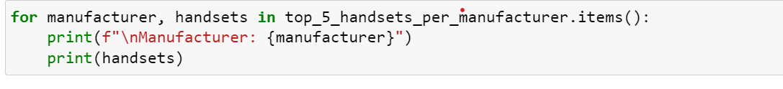
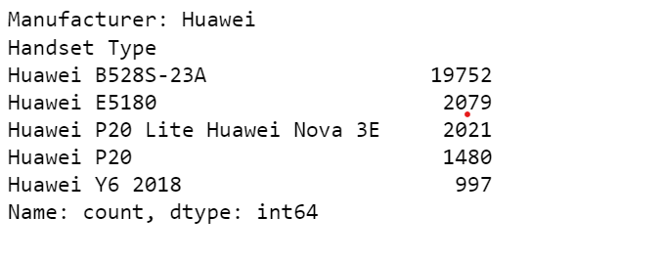
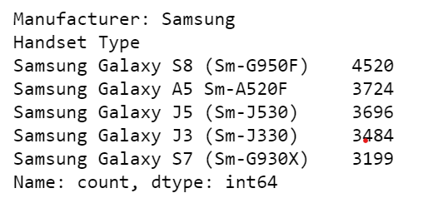
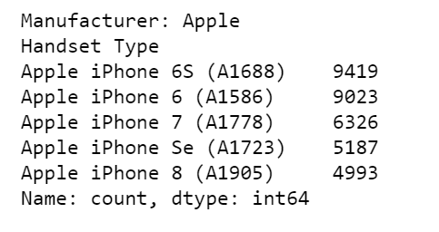
3. Identify the top 5 handsets per top 3 handset manufacturer:

Slide 14
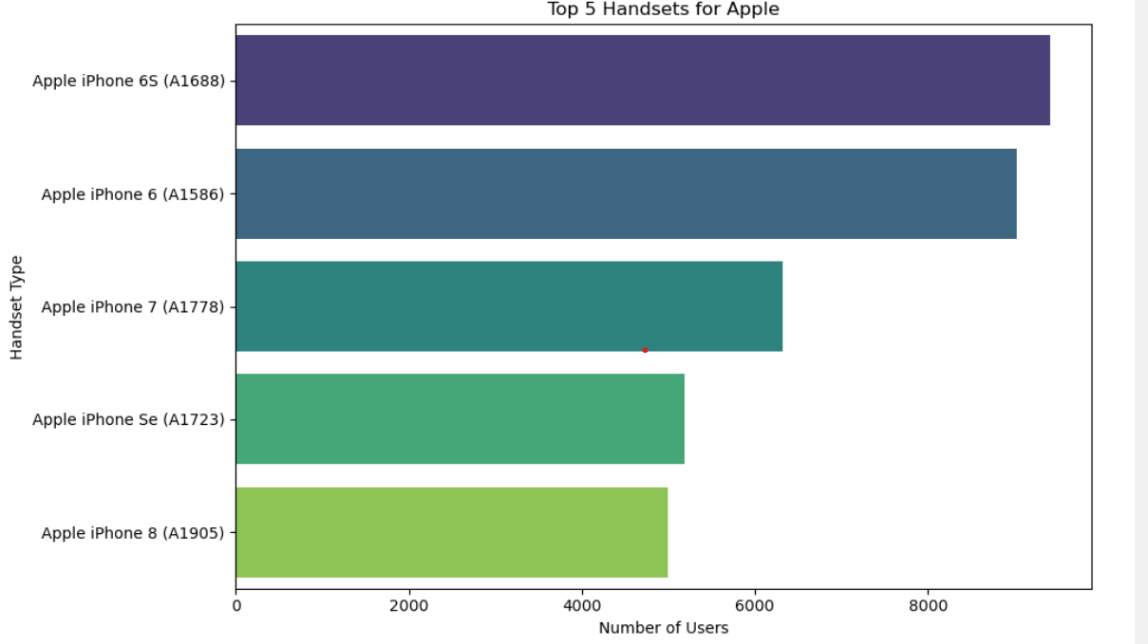
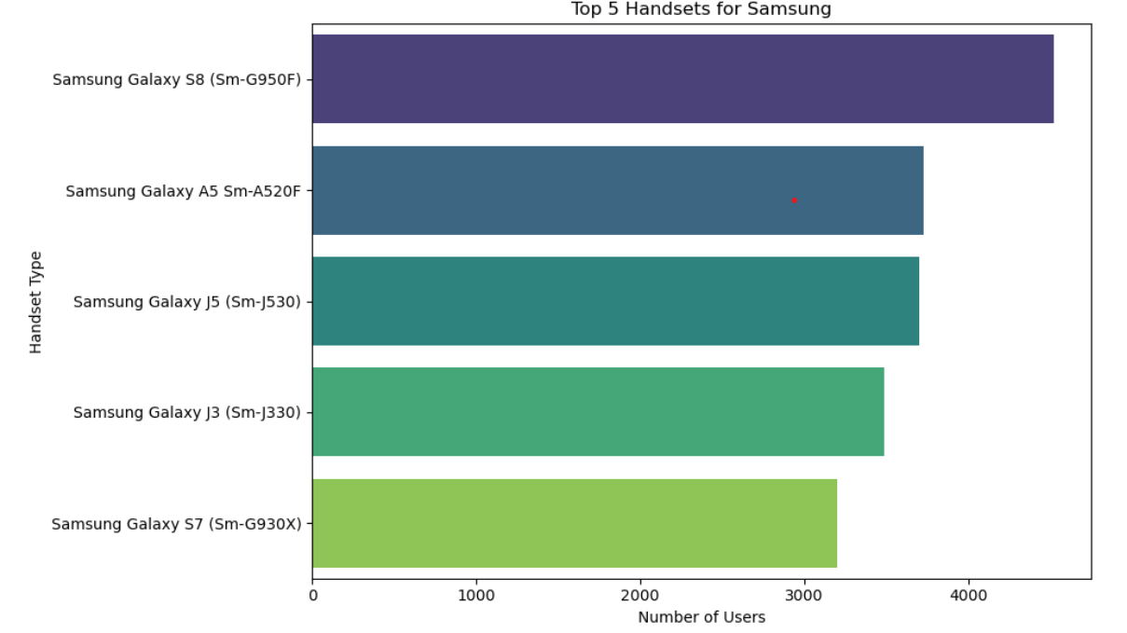

Slide 15
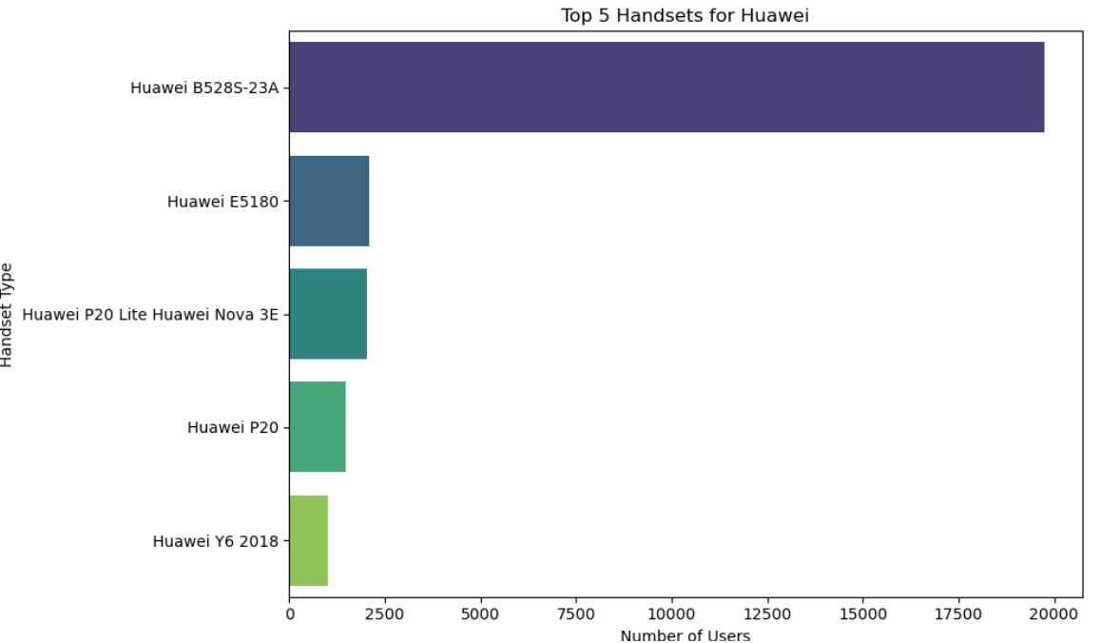
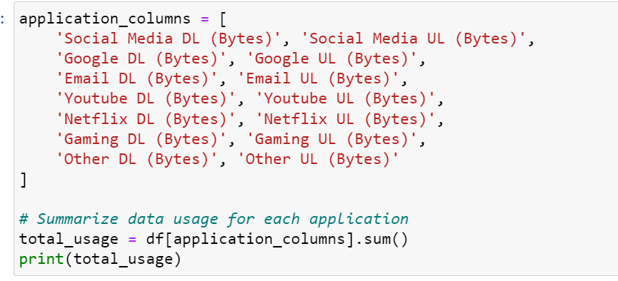
Summing the data usage for each application

Slide 16
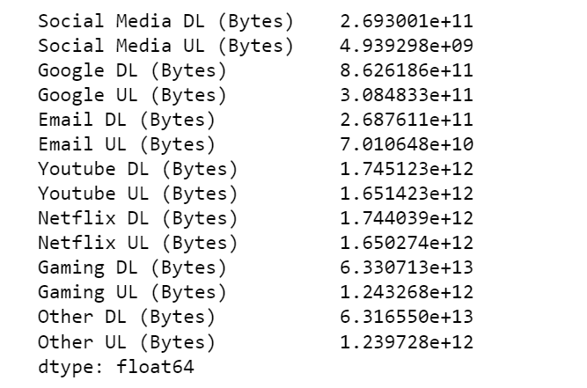
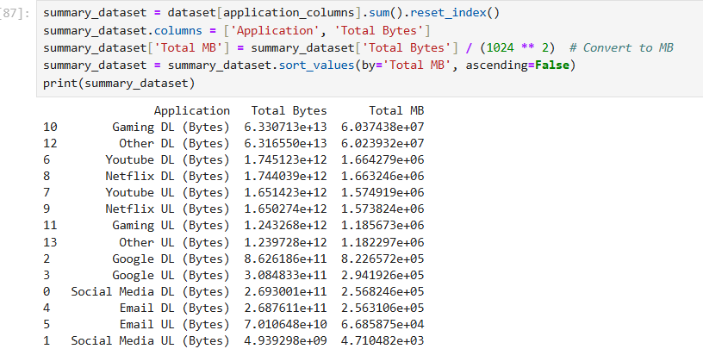

Slide 17
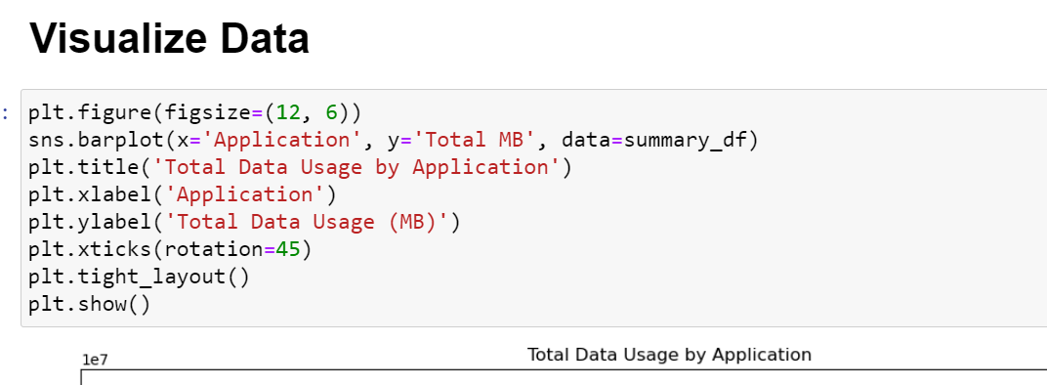
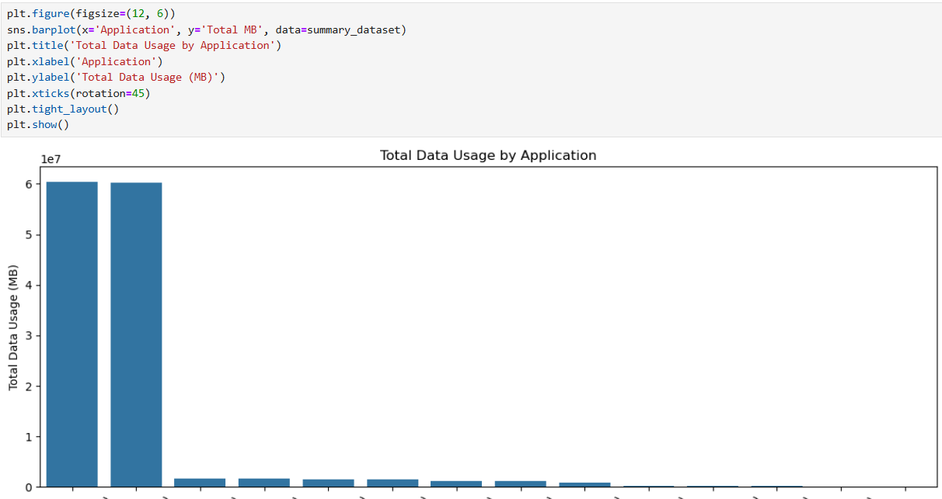

Slide 18
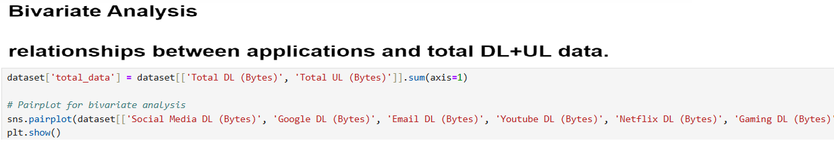
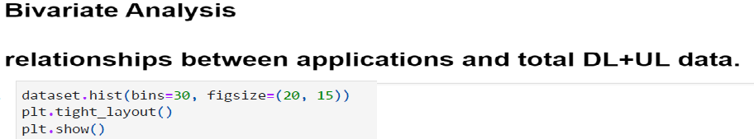
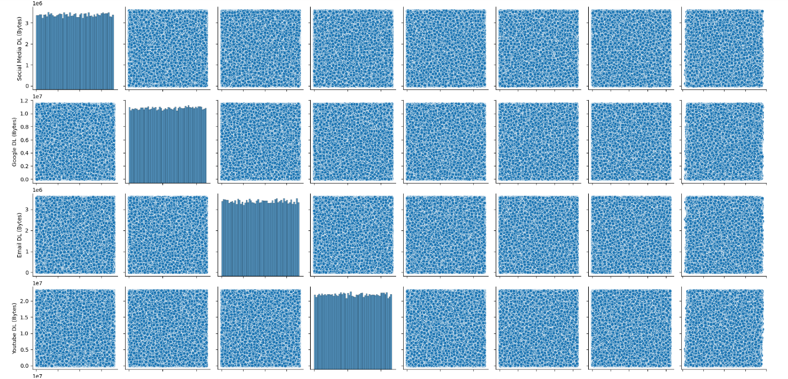

Slide 19
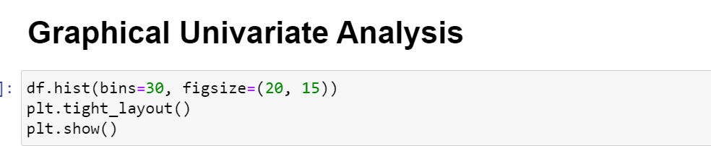
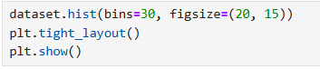
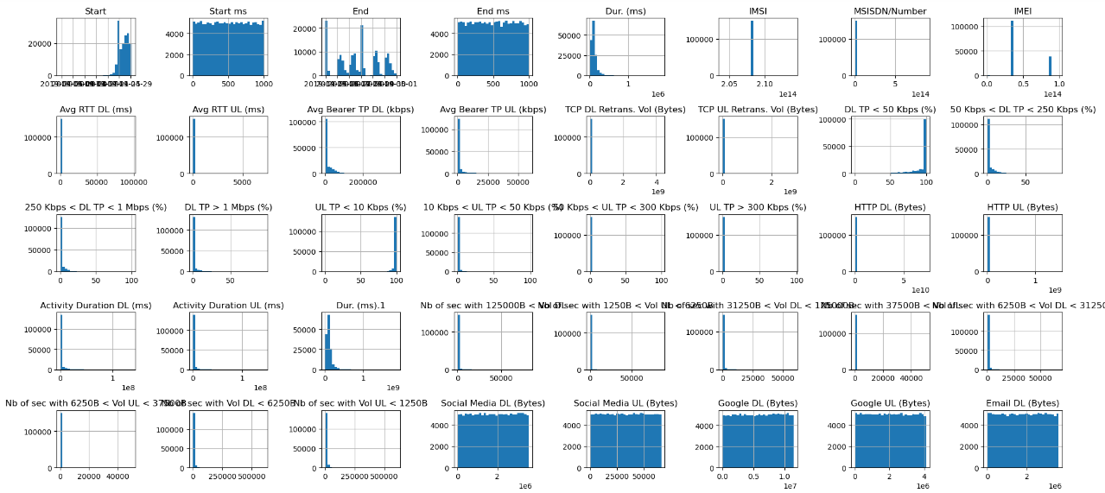

Slide 20
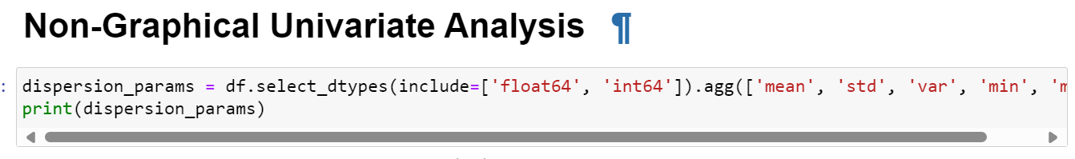
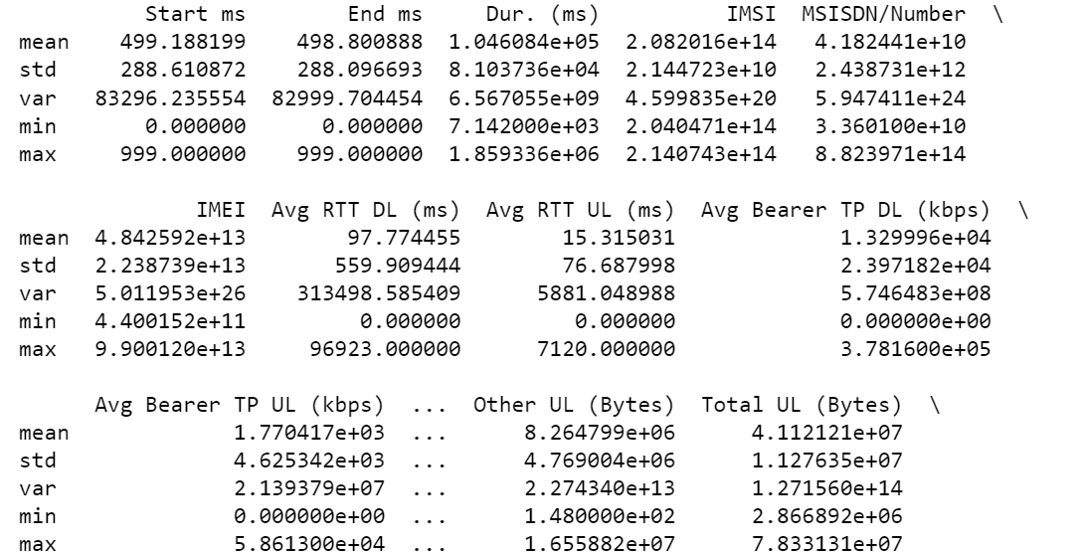

Slide 21
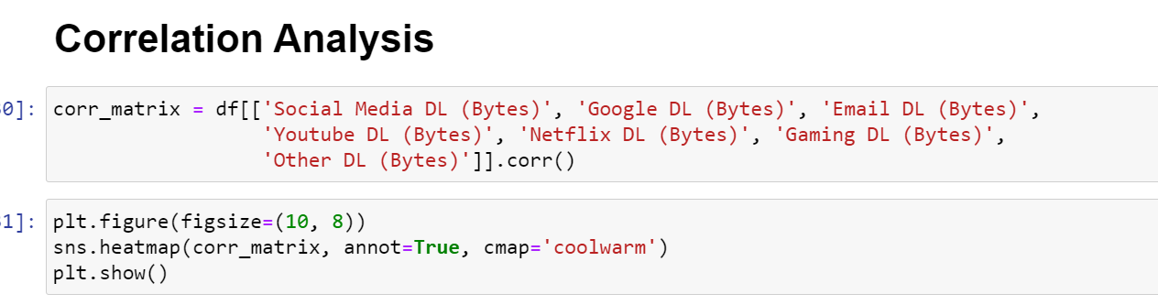
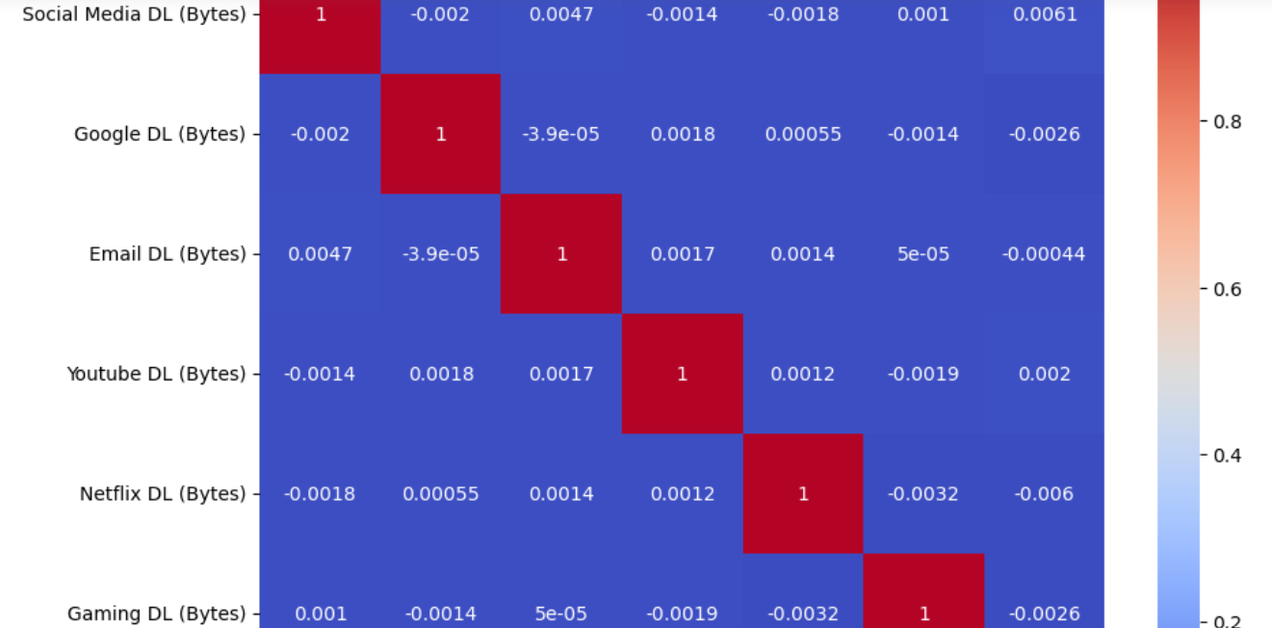

Slide 22
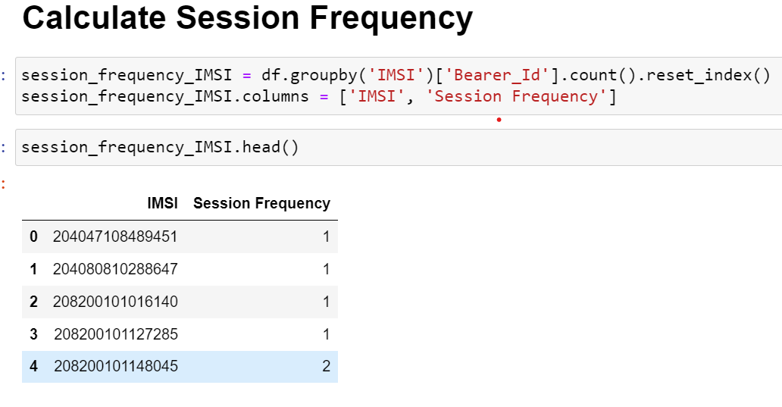
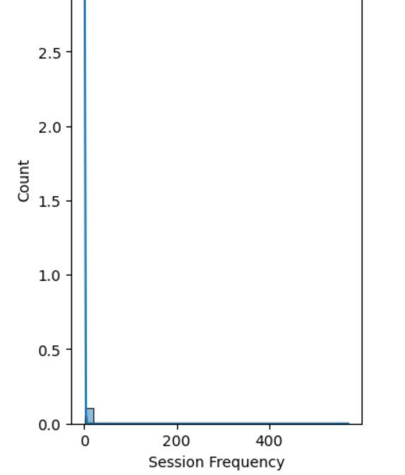
Task 2 - User Engagement Analysis

Slide 23
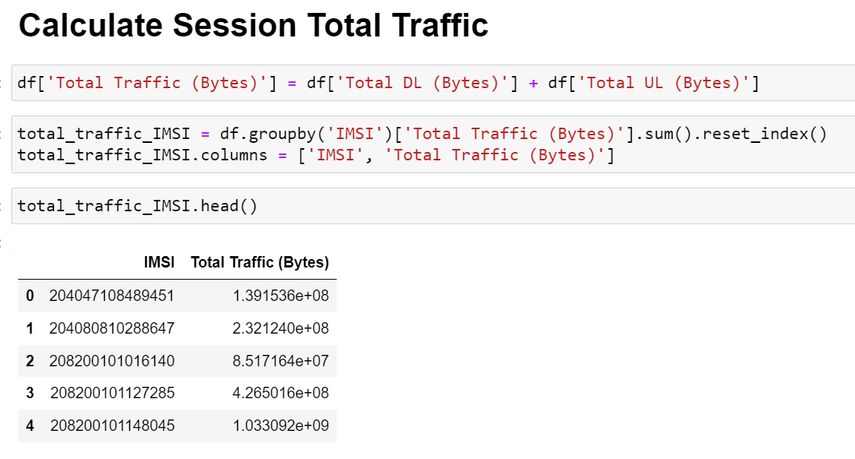
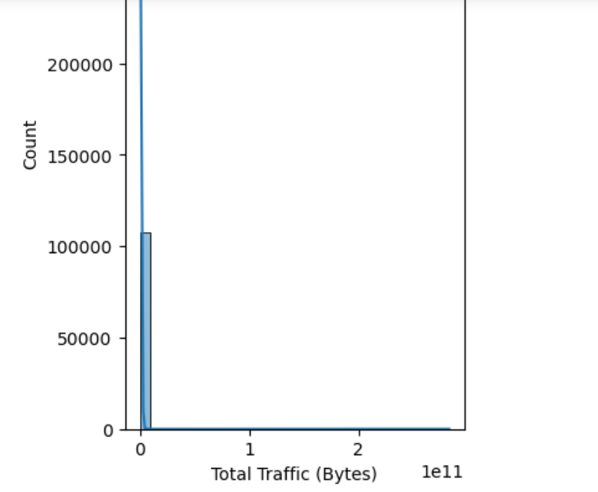

Slide 24
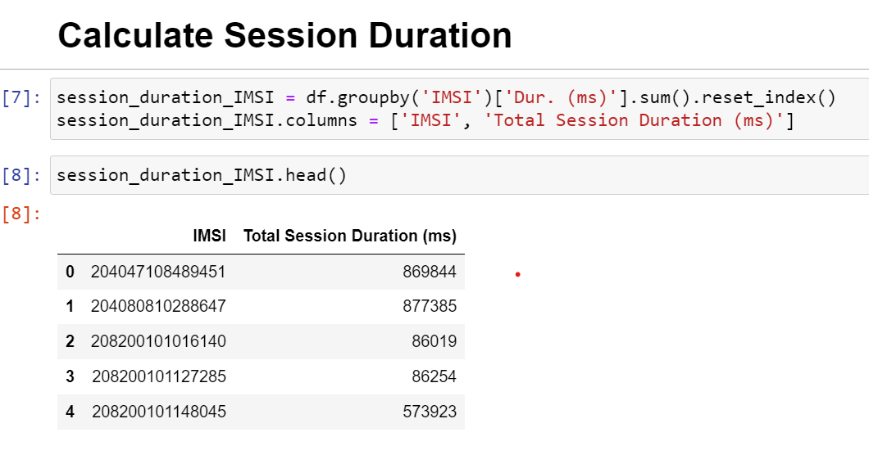
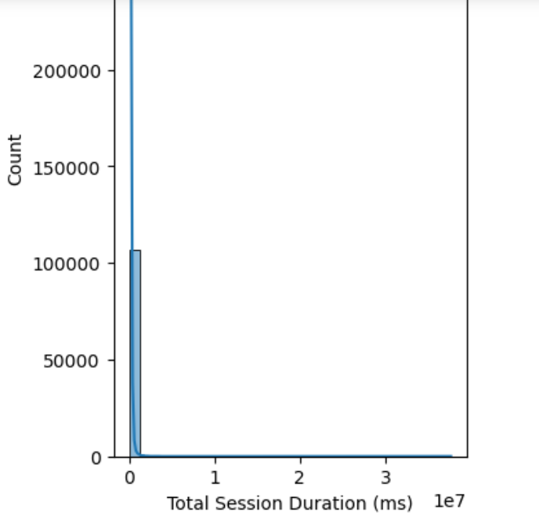

Slide 25
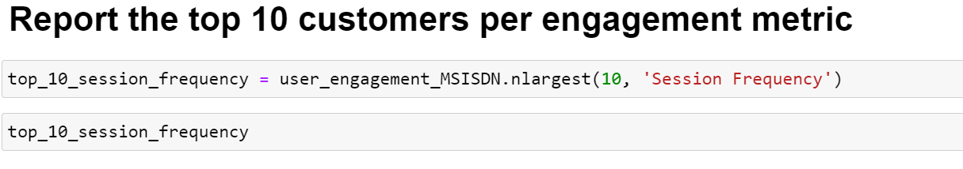
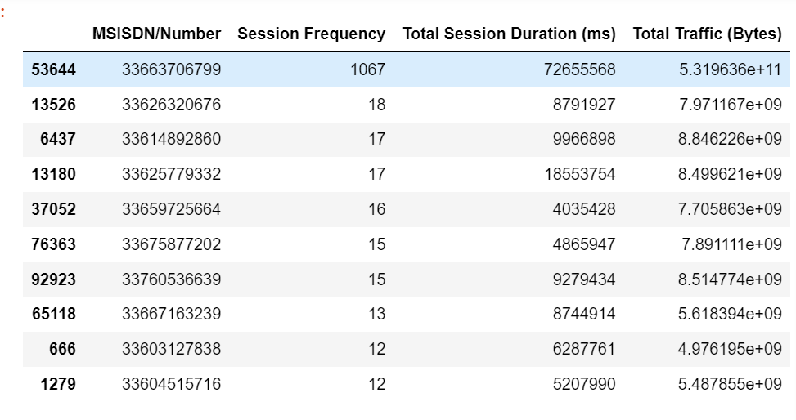

Slide 26
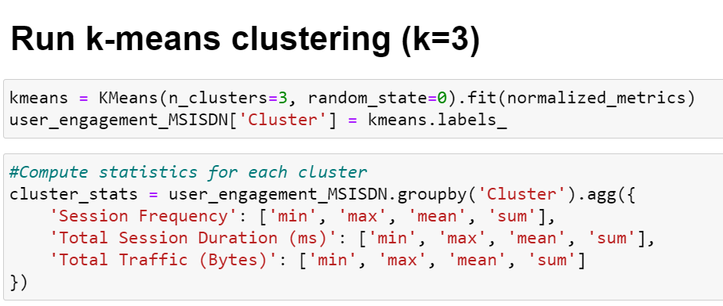
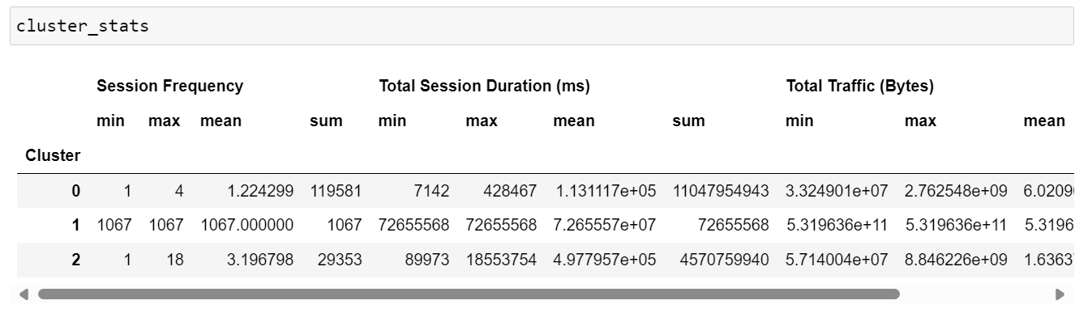

Slide 27
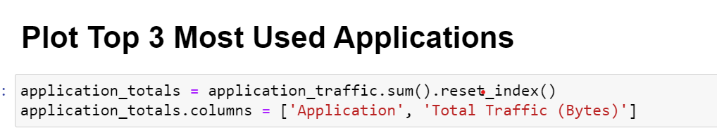
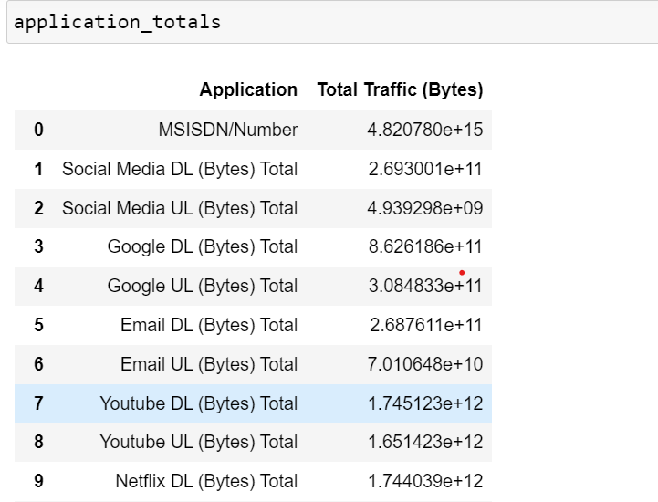

Slide 28
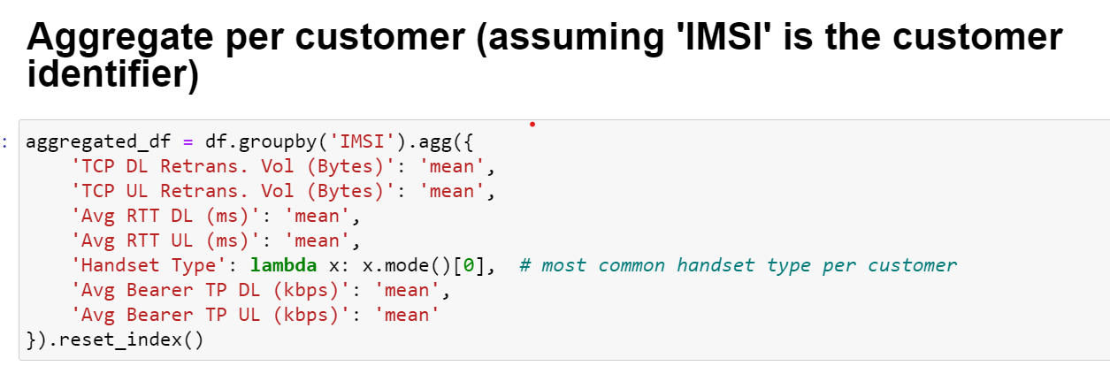
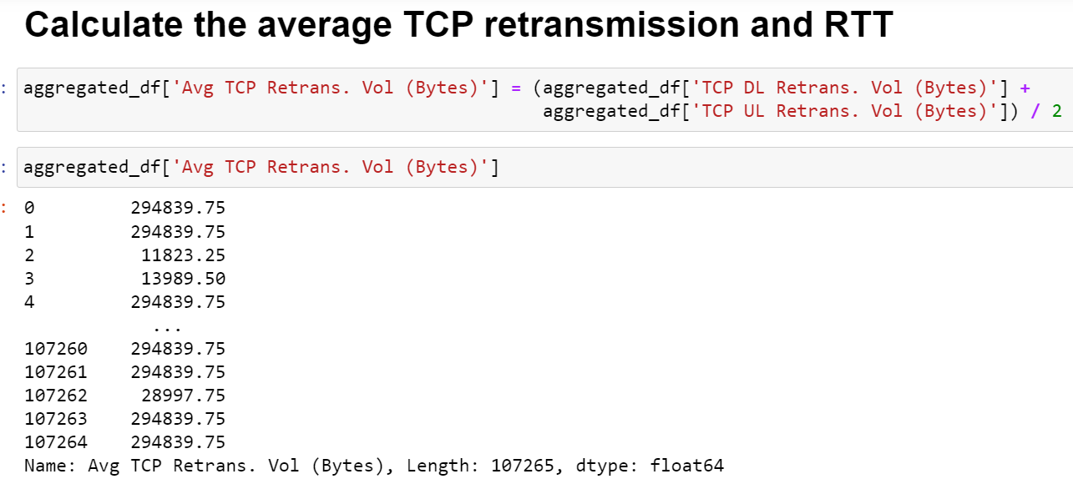
Task 3 - Experience Analytics

Slide 29
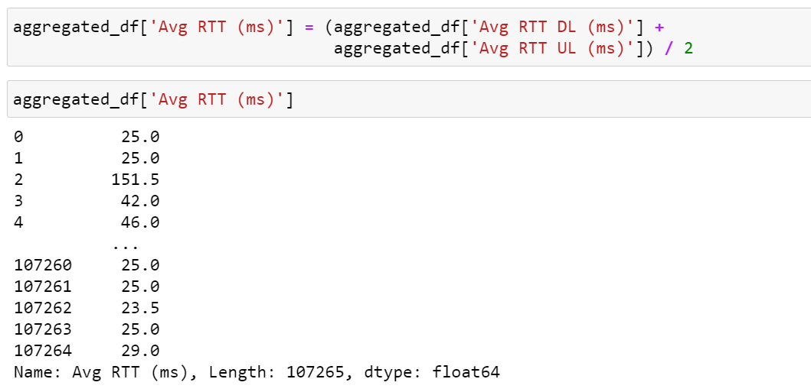
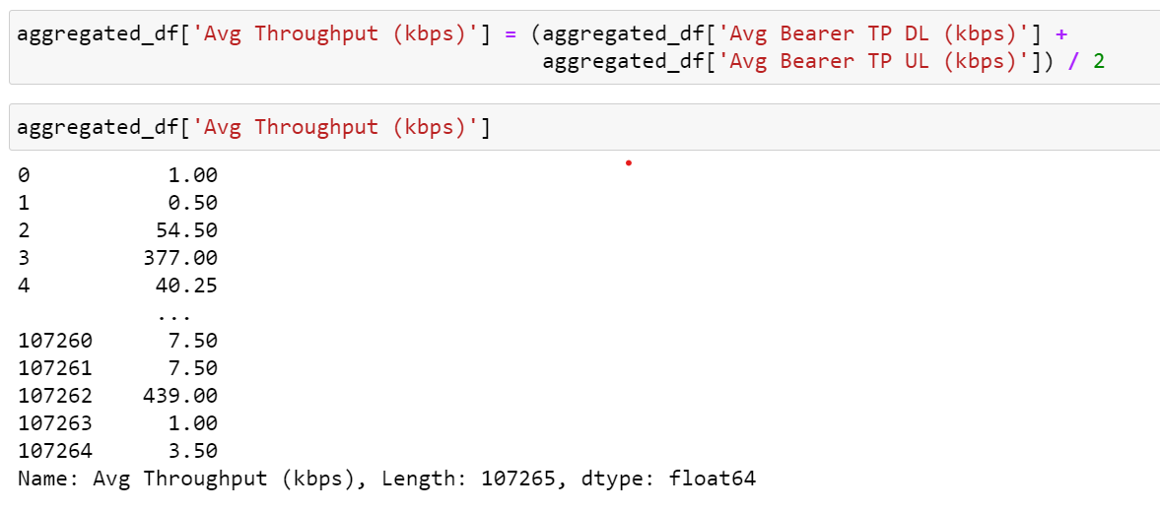

Slide 30
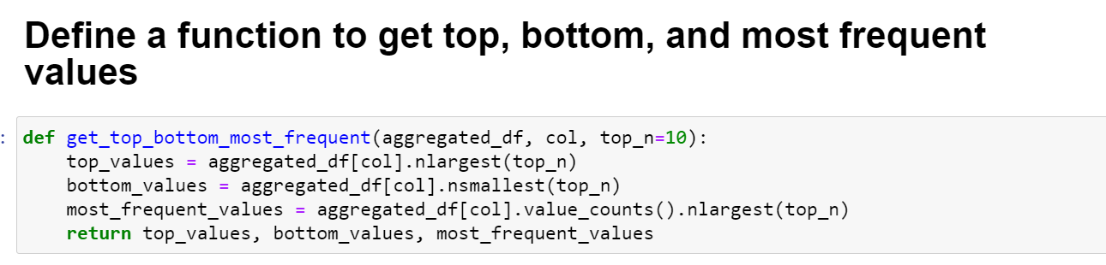
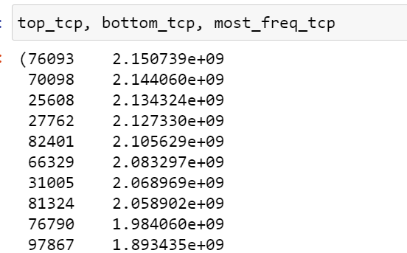



Slide 31



Slide 32


Slide 33



Slide 34


Slide 35



Slide 36

Task 4 - Satisfaction Analysis

Slide 37



Slide 38


Slide 39



Slide 40




Slide 41


Slide 42



Slide 43


Slide 44
Chapter - 4
4. Results:
Limitations:
– Some of the columns in the datasets have large percentages of missing values, thus cannot be analysed.
– The data has no timestamp. It might contain old records which might give a false overview of the current situation.
– The analysis is focused only on the user leaving out potential insights that could be obtained from other aspects like handsets-analysis.
– The call detail record (voice channel) is ignored and more focus is put on data sessions detail record.

Slide 45
Recommendations:
– The company has some weaknesses and strengths based on the analysis. It is worth buying with some changes to be made:
● The handset types should be stocked depending on their number of users.
● More gaming handsets should be introduced given that majority of traffic is as a result of games.
● More features should be added to the existing gaming apps to increase sessions traffic.
● Handsets with a wide variety of applications should be introduced to in order to capture the attention of less engaged users.
● Poor performing handsets based on RTT, TP and TCP values should be replaced by the excellent performers.

Slide 46
Chapter - 5
5. Conclusions:
After conducting an extensive analysis of TellCo’s user data, we have identified several key insights and opportunities for growth:
1.User Overview:
The top 10 handsets and top 3 manufacturers dominate the market. Marketing strategies should target these popular devices to maximize reach.
The aggregated user behavior data highlights significant usage patterns across various applications, providing a clear picture of customer preferences.
2.User Engagement:
High engagement metrics were observed for users frequently accessing social media, YouTube, and Netflix. Enhancing network resources for these applications could improve user satisfaction and retention.
K-means clustering revealed distinct user segments based on engagement levels, allowing for targeted marketing and resource allocation.

Slide 47
3.User Experience:
Average throughput and TCP retransmission rates vary across handset types, indicating potential areas for network optimization.
Clustering users based on experience metrics identified groups with specific needs and challenges, guiding network improvement efforts.
4.User Satisfaction:
Combining engagement and experience scores provided a comprehensive satisfaction score. The regression model accurately predicted user satisfaction, aiding in proactive service improvements.
Clustering satisfaction scores identified distinct user groups, enabling tailored customer service strategies.

Slide 48


